Slide 1

Social Organization
Jas

Slide 2
Intro
How do you define social organization ?
• In Sociology, a social organization is a pattern of relationships between and among individuals and social groups.
• Aspects of social organization are presented in all social situations where a few or more people are thrown into a set of interrelated activities arising from the operation of social norms.

Slide 3
Definition:
• Ougburn and Nimkoff defined organization as an articulation of different parts which perform various functions; it is an active group device for getting something done”.
• Collins Dictionary of Sociology defined organization is “A type of collectivity established for the pursuit of specific aims or goals characterized by a formal structure of rules, authority relations, a division of labor and limited membership or admission”

Slide 4
While organizations link many like-minded people, it can also cause a separation with others not in their organization due to the differences in thought.

Slide 5
Think about an example of Social organization based on your current perception
A college
A enterprise
An NGO
English Department
A political party
A military
A hospital
A government
Notes:
If we view social organization as a collective agent with similar aim
Families
Smaller scaled social organizations include many everyday groups that people would not even think have these characteristics. These small social organizations can include things such as bands, clubs, or even sports teams.

Slide 6
Small-scale v.s. Large-scale
Small: a school sports team
Large: a hospital; Within the hospital are small social organization—for example, the nursing staff and the surgery team.
Aside from the difference in size, what are the differences between the two organizations?
Notes:
a school sports team, The members of the team all have the same goals, which is to win, and they all work together to accomplish that common goal. It is also clear to see the structure in the team. While everyone has the same goal in mind, they have different roles, or positions, that play a part to get there. To achieve their goal they must be united.
Within the hospital are small social organization—for example, the nursing staff and the surgery team. These smaller organizations work closer together to accomplish more for their area, which in turn makes the hospital more successful and long lasting. As a whole, the hospital contains all the characteristics of being a social organization. In a hospital, there are various relationships between all of the members of the staff and also with the patients.
There is also division of labor, structure, cohesiveness, and communication systems. To operate to the utmost effectiveness, a hospital needs to contain all of the characteristics of a social organization because that is what makes it strong. Without one of these things, it would be difficult for this organization to run.

Slide 7
Mission
Small: a school sports team; all the members have the same goal—to win
Large: a hospital; to make the hospital running long and lasting
Different social organizations have different missions/goals

Slide 8
Relationships
Small: a school sports team
Large: a hospital
Does everyone in these social organizations have the same role/job/responsibilities?

Slide 9
• Duncan Mitchell explained social organization as , “the interdependence of parts, which is an essential characteristics of all enduring collective entities: groups, communities and societies”
• Eliott and Merrill defined, “organization is a state of being, a condition in which the various institutions in a society are functioning in accordance with their recognized or implied purposes”.

Slide 10
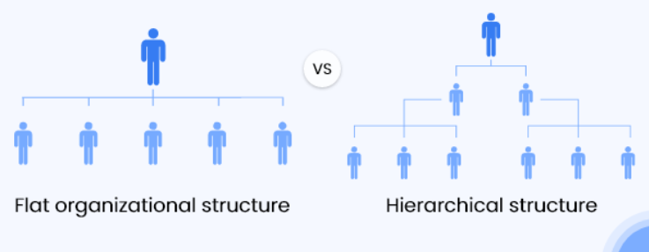
Relationships in social org
Flat v.s Hierarchical

Slide 11
H.M Johnson defined, “organization refers to an aspect of interaction systems”.

Slide 12








Australian labor party
2. UN (United Nations)
5. The ROK Armed Forces
4. Save the Children
3. Hamas
8. University College London
7. People’s court in China
6. CMBChina

Slide 13
Research your social organization
What is it? What does this organization do?
What is their Mission?
What are the different departments/decisions within the organization?
Give one example of the relationship existing in this organization.
Do you think the relationship is flat or hierarchical?
Give one example of the power that a member in your organization has.

Slide 14
Characteristics of Social Organization
• An organization is understood as a mechanism that brings different people together into a network of interaction to perform different functions.
• An organization is always a type of collectivity.
• An organization has its own definite purposes.

Slide 15

What is POWER?

Slide 16
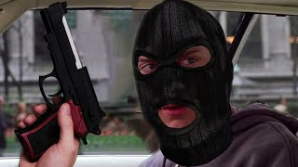
Where does power come from?
Who gives the teacher power?
Who gives president power?
Would you do whatever he asks you to do?
Where does his power come from?

Slide 17
What makes people have “power”?
Ability
Position
The power you have because of you own abilities and skills.
E.g. I have power in English teaching is because of my teaching skills/ability.
Do I still have these power after I leave the school?
The power you possess only because you are in the current position of a social organization.
E.g.The head of English department.
Homeroom teacher
Do I still have these power after I leave the school?

Slide 18
Power
What kind of power is necessary for us to survive/be alive?
Physical Power: At a basic level, humans need a certain degree of physical power or energy to survive. This includes the power to procure food, shelter, and protect oneself from harm. Without this basic power, survival is challenging.
Social Power: Social power, such as influence or control over one’s environment and interactions, is not strictly necessary for survival but is crucial for a fulfilling and productive life in society. In a social context, lacking power often means reduced ability to influence one’s circumstances, which can lead to marginalization.

Slide 19
Power v.s Rights
Power can be understood as the ability or capacity to do something or act in a particular way, often implying control over resources, people, or situations.
Rights, on the other hand, are entitlements or permissions usually granted by a legal system or social consensus, giving individuals the freedom to act or be treated in certain ways.
In society, can people live/survive without power? Can people survive without rights?

Slide 20
Rights
What do human beings need to survive?
What things help us to grow physically?
What things help us to succeed in life?
Notes:
Food, water, a place to live (from bad weather),

Slide 21
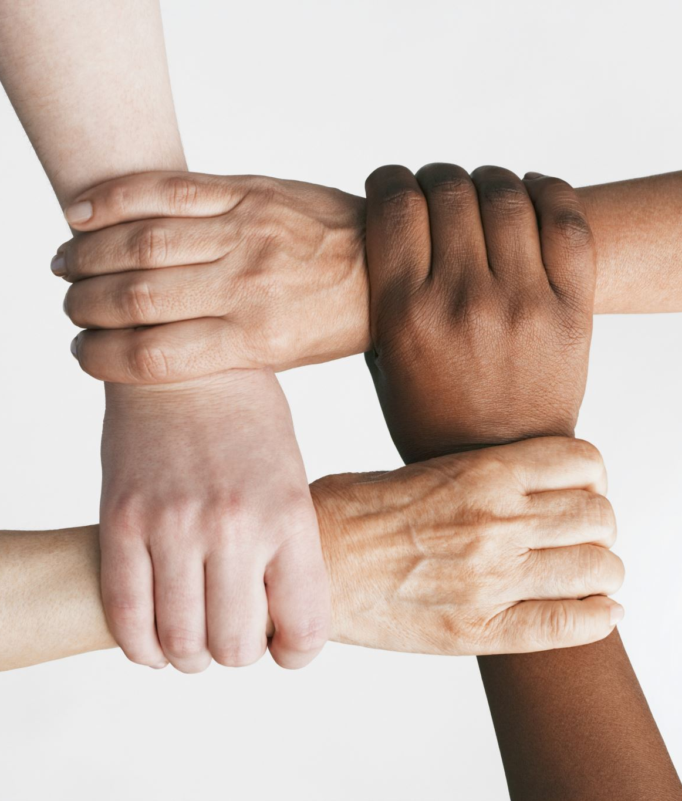
Human rights

Slide 22
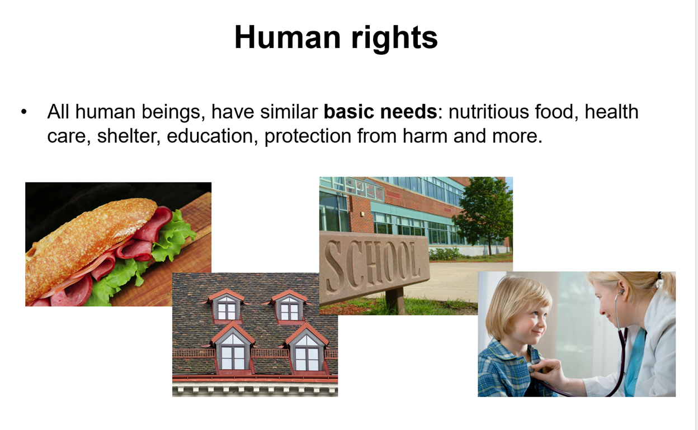
Notes:
Shelter: protect us from natural disasters and extreme weather

Slide 23
Human beings need these things to live and grow and to be human.
Needs are different to wants. Wants are not necessary for a person to survive, grow and develop.
Everyone of us has the right to have these needs fulfilled.
These rights are called human rights
Notes:
Basic survival or thrive in the modern society?
从最基本的物质生存意义上来说——需要食物、水、住所和安全——正规教育并不是严格必要的。人类可以在没有正规教育的情况下生存，这一点在人类历史的大部分时期以及生活在极其偏远或原始条件下的个人的例子中得到了证明。
然而，当考虑在当代社会繁荣的背景下生存时，教育就变得至关重要。
In conclusion, while formal education might not be necessary for the most basic form of physical survival, it is essential for an individual's holistic development, well-being, and effective participation in modern society. It empowers individuals and communities, leading to better social, economic, and health outcomes, which are crucial elements for thriving in today's world.

Slide 24
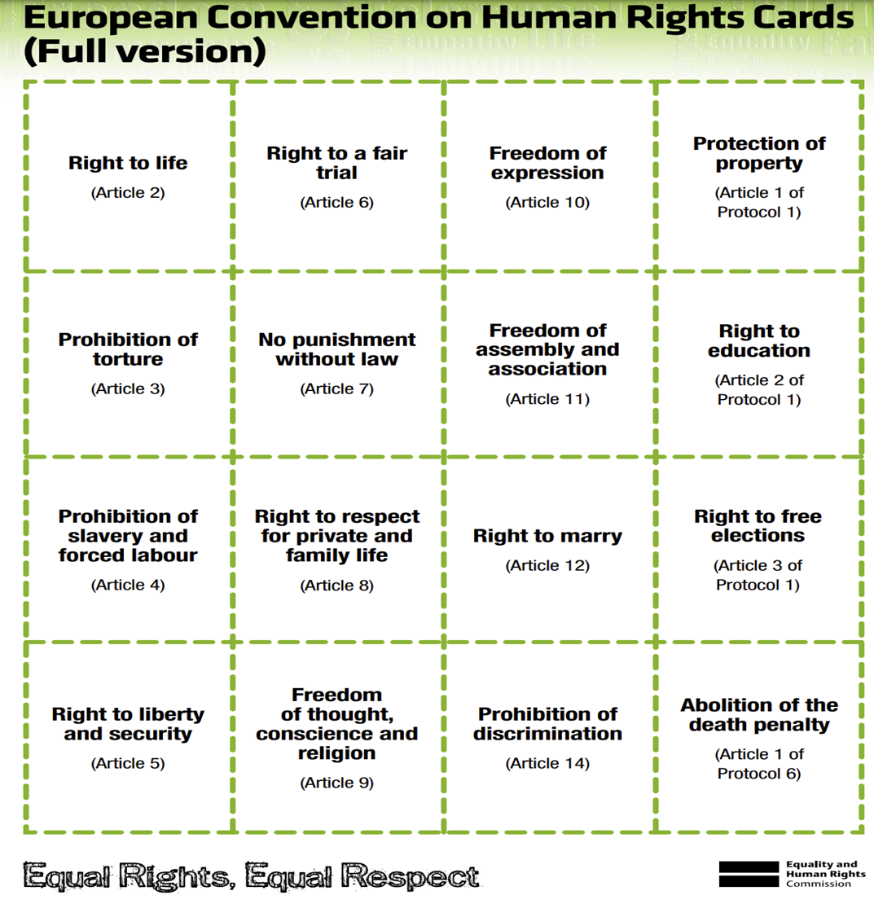
Each of these rights will cost you $100 USD.
You have $1000 USD to spend as a group.
Choose which rights you will ‘buy’ as a Group.
Justify why you make the choices you do
Notes:
Right to a fair trial: guarantees the rights of criminal defendants, including the right to a public trial without unnecessary delay, the right to a lawyer, the right to an impartial jury,
Protection property: housing subsidies to income tax credits to welfare payments.
Prohibition of torture: No one shall be subjected to torture or to onhuman or degrading treatment or punishment in all circumstances
Freedom of assembly and association: right of individuals to interact and organize among themselves to collectively express, promote, pursue and defend common interests.
Right to liberty and security: this right protects against the unlawful or arbitrary deprivation of liberty. A person who is arrested or detained is entitled to certain minimum rights. They also have a right to a brought to a trial without unreasonable delay.

Slide 25
The modern concept of human rights was created after the Second World War.
Why?
About six million European Jews were killed - about 2/3 of the population of European Jews.
Total number of Holocaust victims - between 11 million and 17 million people killed!

Slide 26
The Holocaust
During World War II, Jewish people faced unprecedented persecution and genocide in an event known as the Holocaust. Orchestrated by Adolf Hitler and the Nazi regime in Germany, this systematic campaign aimed to exterminate the entire Jewish population of Europe, along with other groups deemed "undesirable," including Romani people, disabled individuals, political dissidents, homosexuals, and others. Here's an overview of what happened:
Notes:
Initial persecution: The Nuremberg Laws (Germany), stripping Jews of their citizenship and implementing racial segregation. Hitler
From 1940 onwards: Jews were forcibly relocated into crowded, isolated ghettos in cities across Europe, most notably in Warsaw and Łódź. Conditions in these ghettos were dire, with severe overcrowding, starvation, and disease.

Slide 27
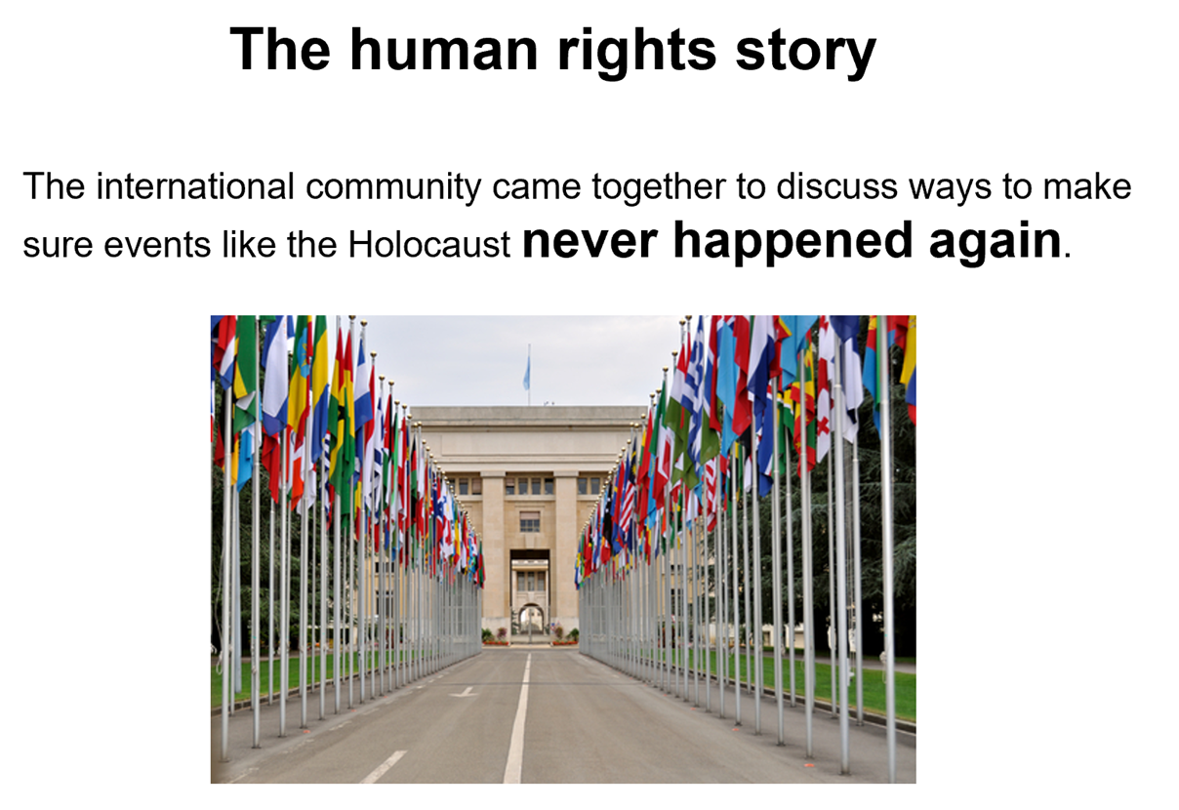
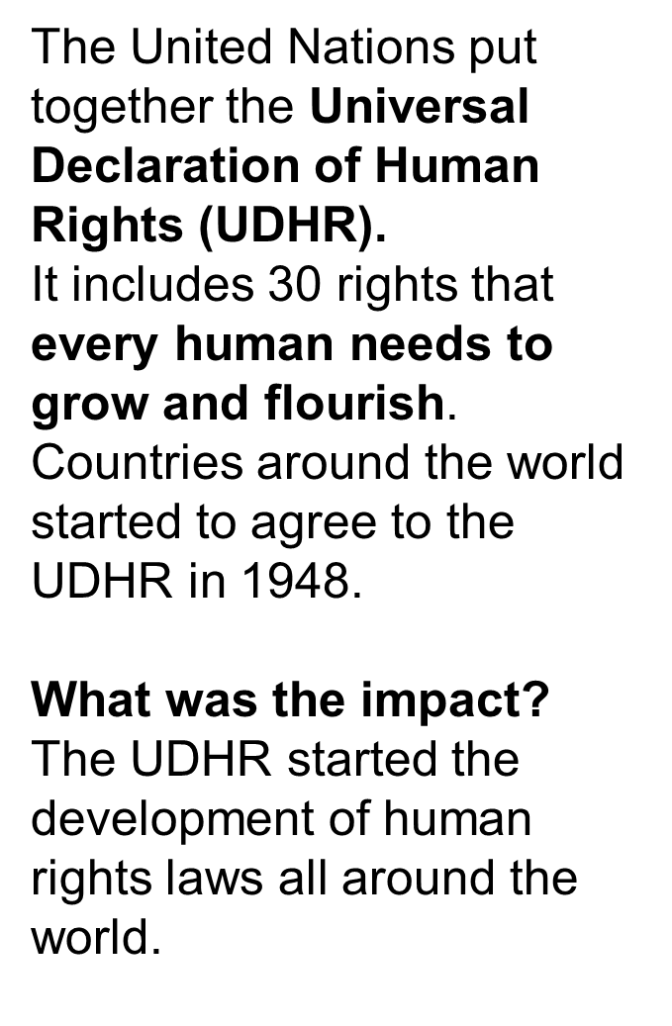

Slide 28
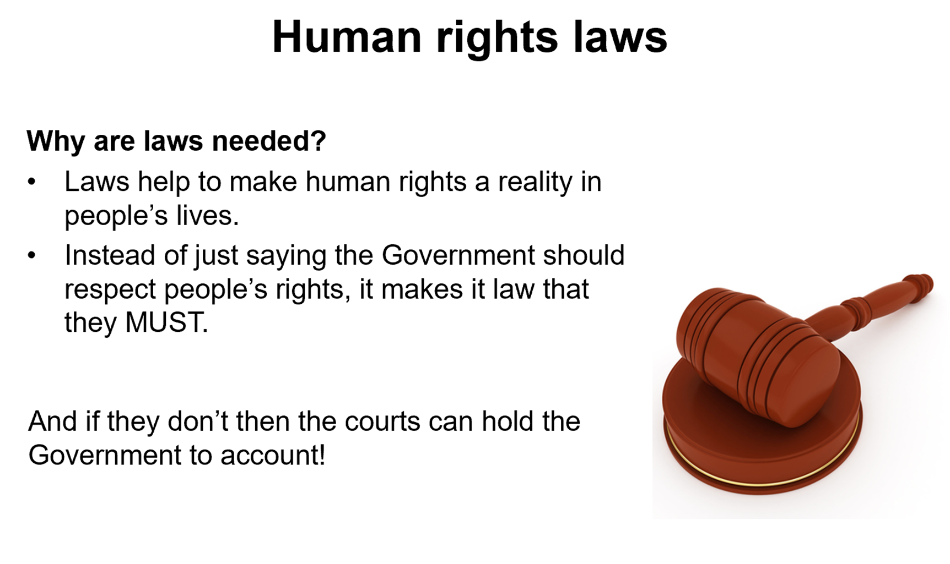
Notes:
Only laws make them the “must” instead of “should”, that means if you do not obey these legislations you would be

Slide 29
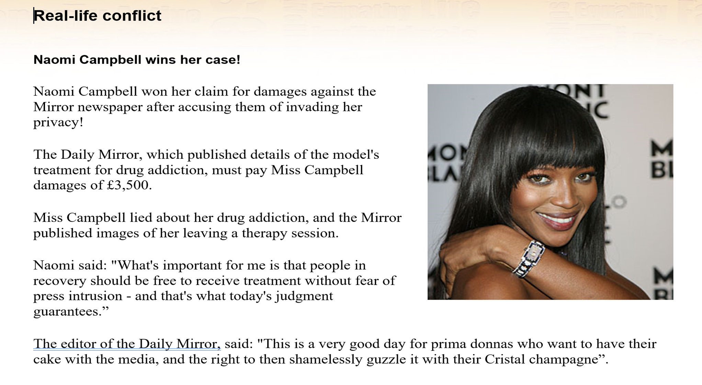

Slide 30
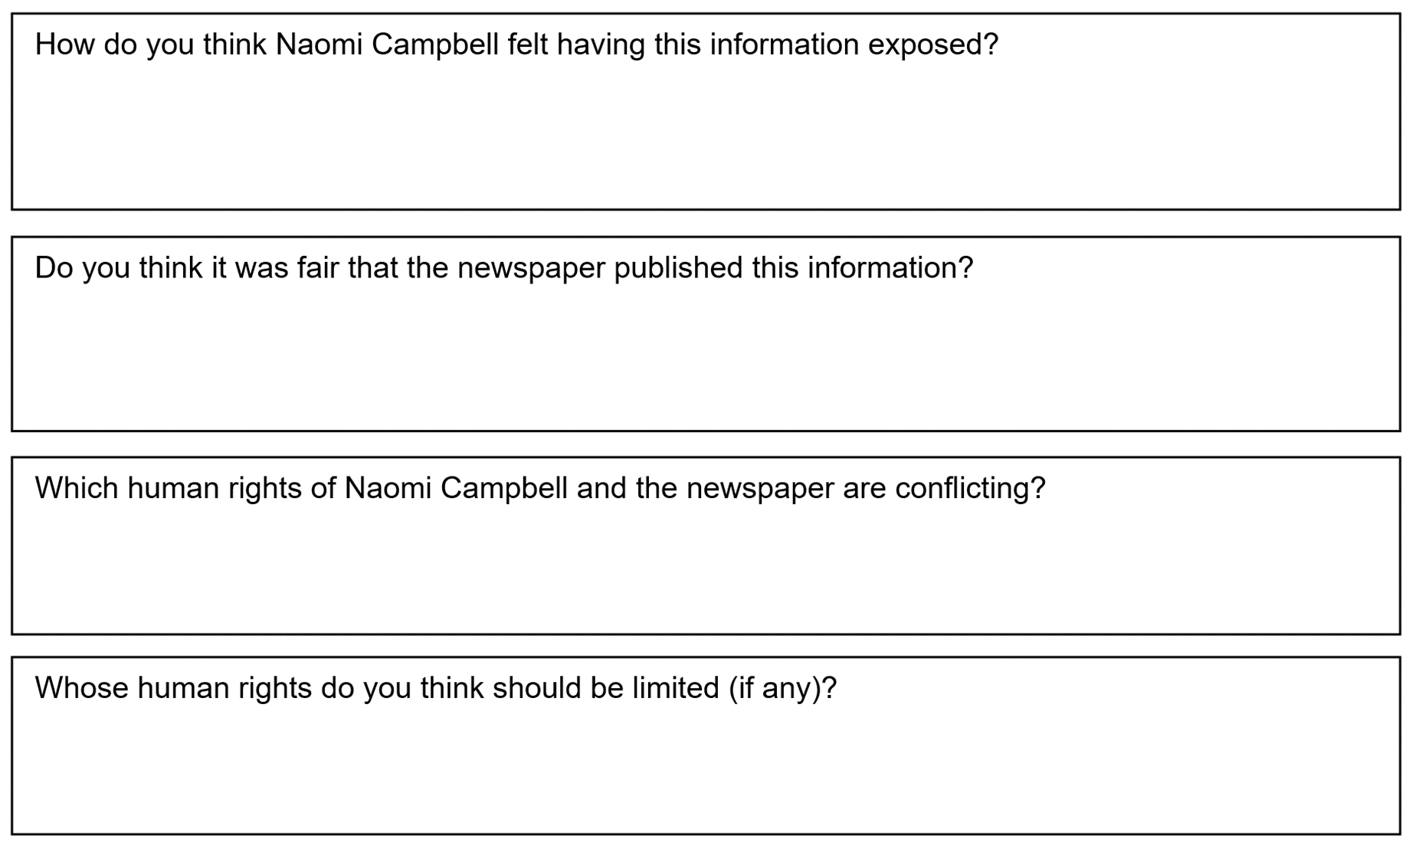

Slide 31
What role do rules and regulations play in the formation of a society?
Notes:
Each group write down 5 answers to this question

